Slide 1
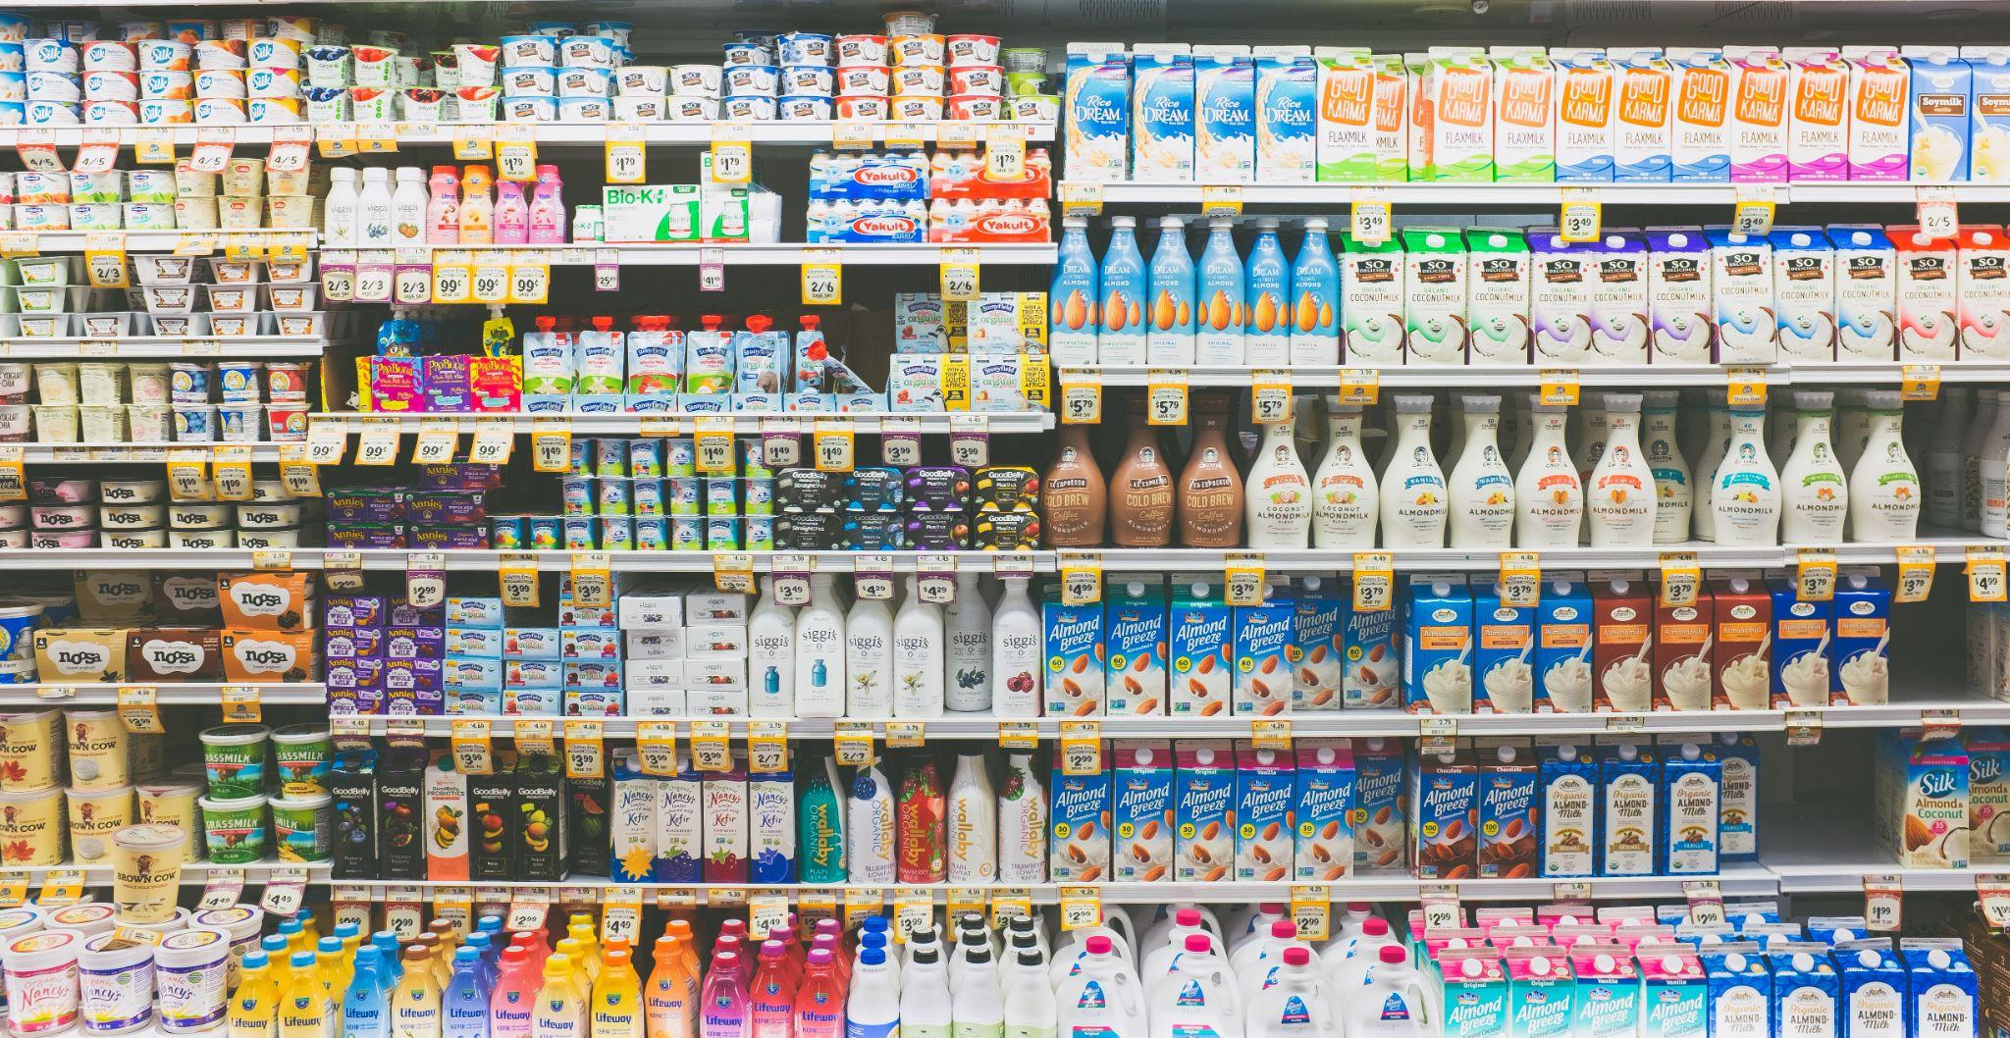
Customer Purchasing Pattern Study
Based on Historical Data
Team1
Qianrong Wen, Ting-Ann Lu, Risheng Guo,
Luke Hong, Kexi Pi, Yesol Lee (Sally)

Slide 2
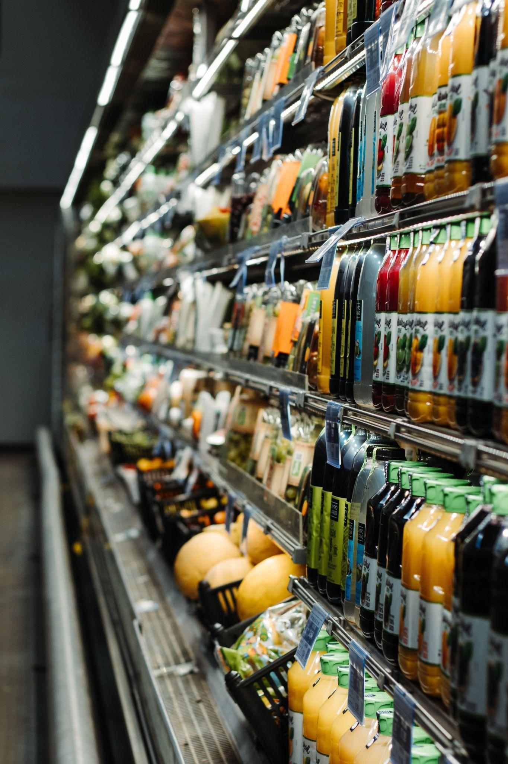
Table of Contents
1
Project Overview
2
Data Preparation
3
Exploratory Data Analysis
4
Customer Persona & Machine Learning
5
Conclusion

Slide 3



Project Overview
Data set: Marketing Analytics (https://www.kaggle.com/jackdaoud/marketing-data)
Data source: Dr. Romero-Hernandex (a professor at UC Berkeley and Hult International Business School)
Business problem: to find relationships between customers’ characteristics and the amount they spend at a retail store.

Slide 4



Data Preparation
Demographic
Purchases
Marketing
Country
Year of birth
Income
Education
Marital status
Kid at home
Teen at home
Amount of spending (6)
Number of purchases (4)
Number of visit to Company web site
Campaign acceptance (6)
Complain

Slide 5
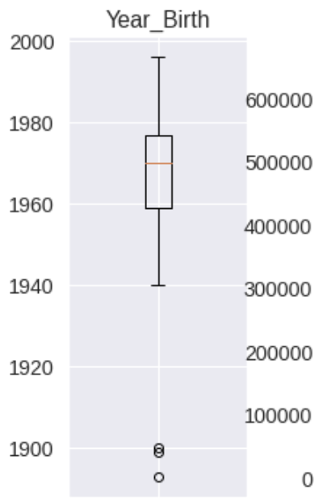
Data Preparation
Column Name
Data Type
Missing Values
Impossible Data
Duplicate
Categories
New columns
<Income>
“ Income”→“Income”
Remove “$,”
Cast into float
<Dt_Customer>
Object → Datetime
24 missing values in Income column
→filled with Median
<Education>
“2nd Cycle”
→ “Master”
<Marital Status>
“YOLO”, “Alone”, “Absurd”
→ “Single”
<Age>
2020 - year of birth
<Total Amount>
Sum of amount from all product categories
<Children>
Number of kid + teen
Final shape of data set = 2237 * 31

Slide 6
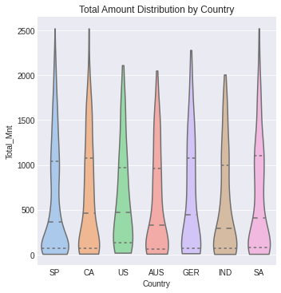



Exploratory Data Analysis
Country
Highest median spending: US
Lowest median spending: India
Highest frugal spending: Spain

Slide 7
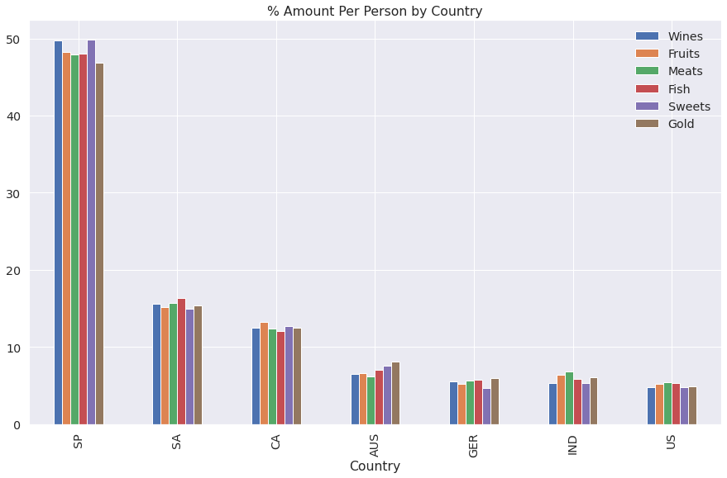
Exploratory Data Analysis
Country
Dominant Country: Spain
Product category preference is consistent across countries

Slide 8
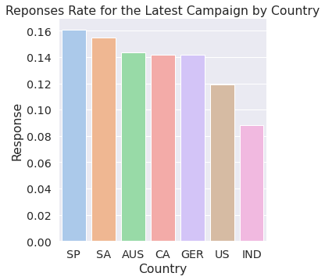
Exploratory Data Analysis
Country
Understanding of baseline response rates per country
Different countries have different sentiments towards campaigns

Slide 9
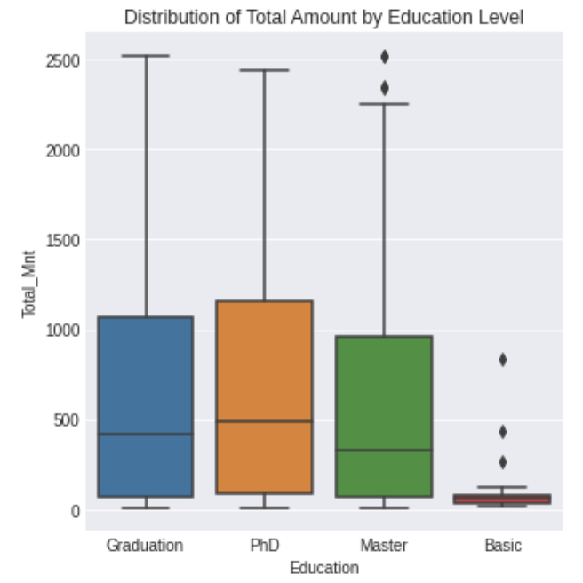
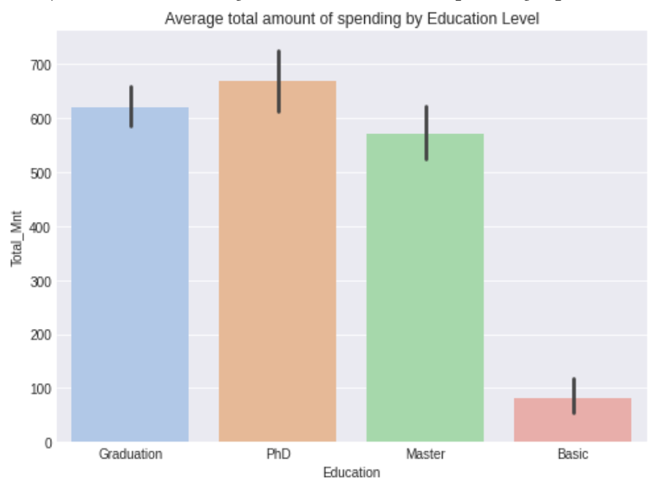
Exploratory Data Analysis
Education
Median: Graduation, Ph.D., Master are similar
Least spending: Basic education level

Slide 10
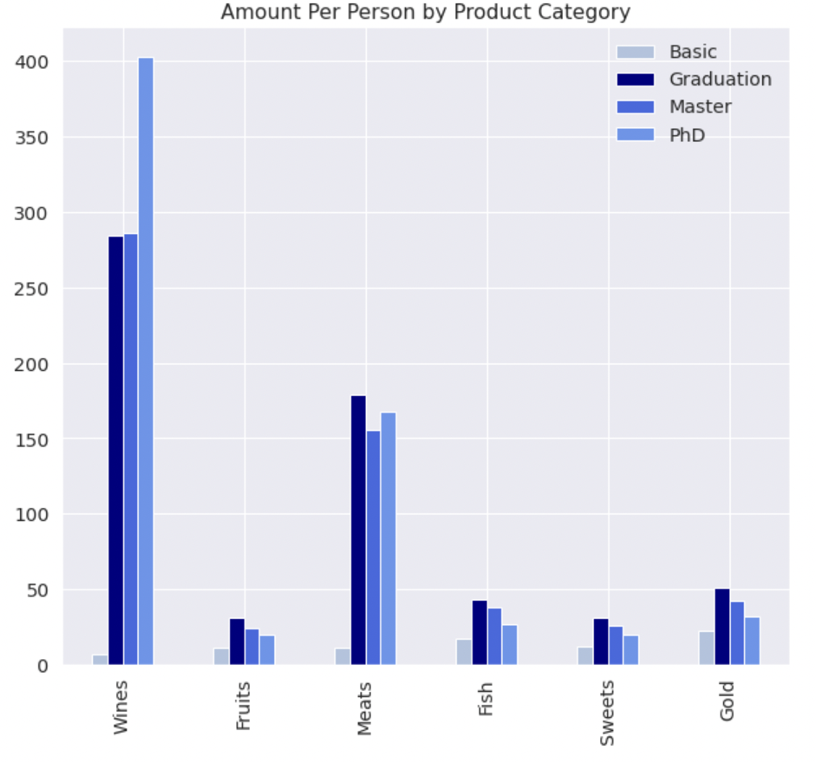
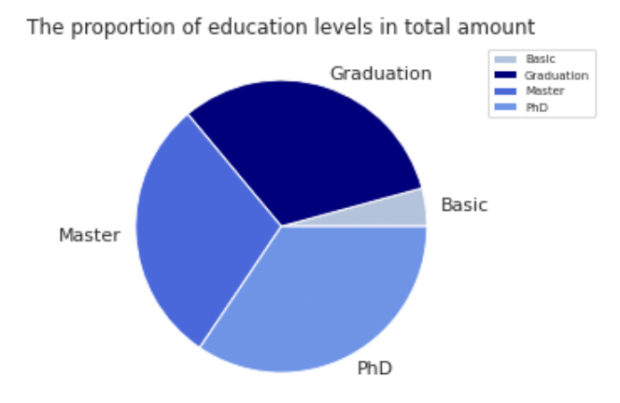
Exploratory Data Analysis
Education
PhD spent significantly more than other education levels on wines

Slide 11
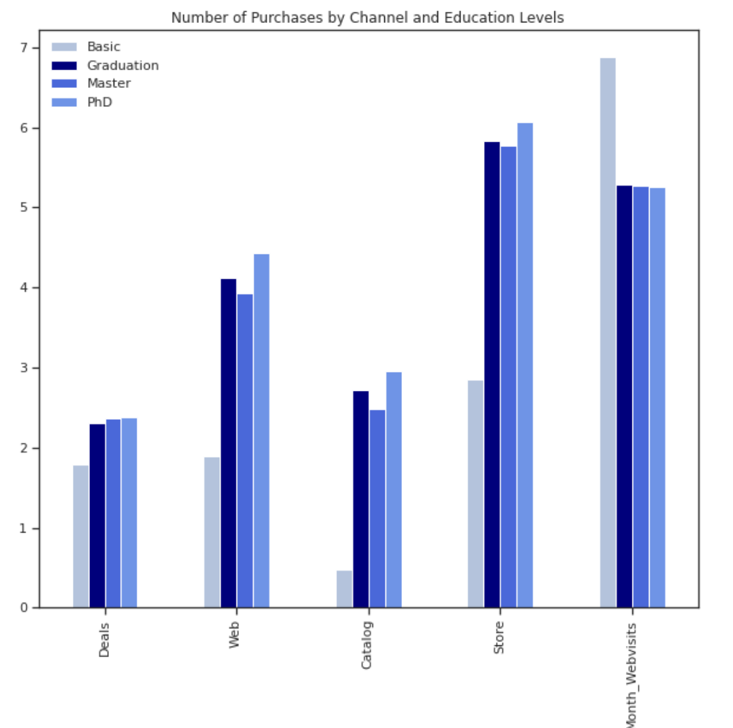
Exploratory Data Analysis
Education
Ph.D: Prefer Store
Basics: Lowest purchase power
Highest number of web visit

Slide 12
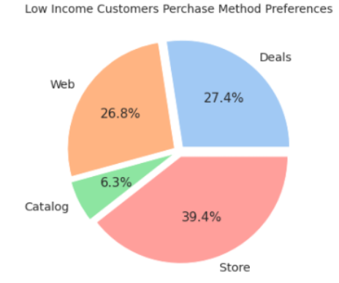
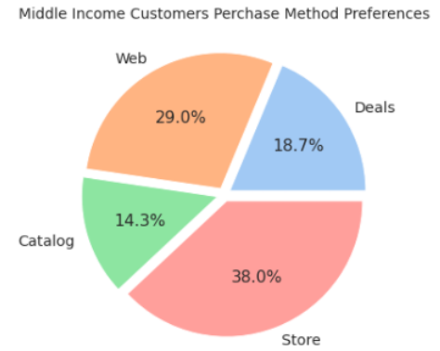
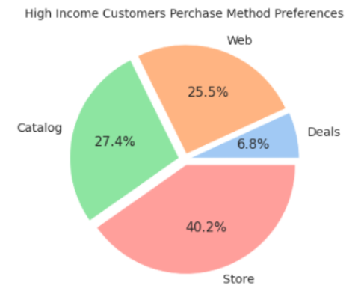
Exploratory Data Analysis
Income
Split Customers into 3 categories
Where they like to buy
Most preferred channel: In Store Purchase

Slide 13
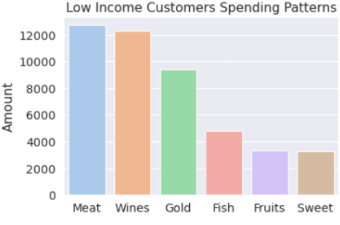
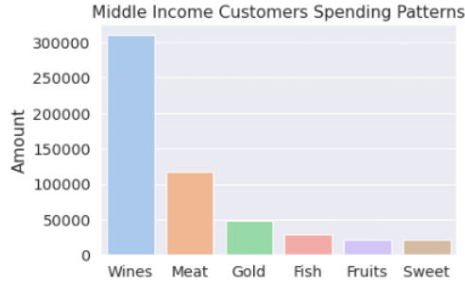
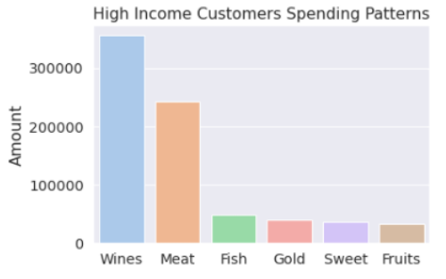
Exploratory Data Analysis
Income
What they like to buy?
Top 1 product categories: Wine

Slide 14
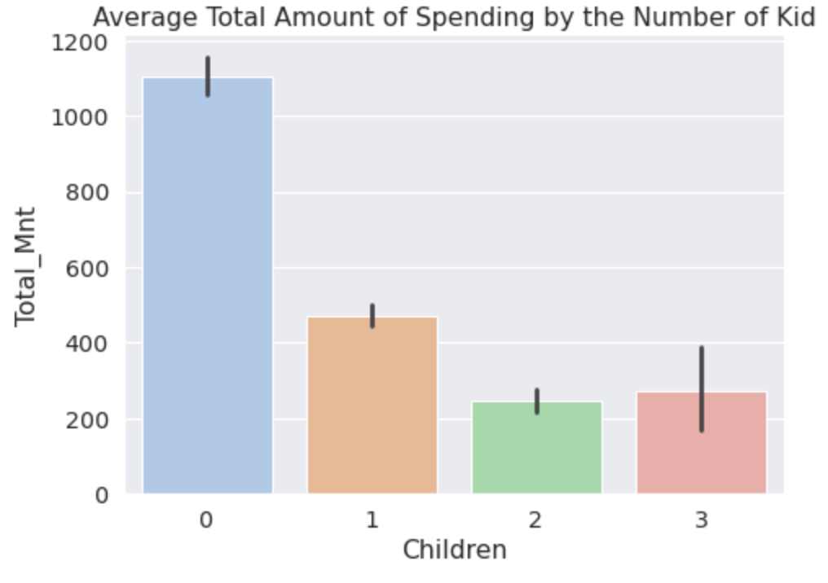
Exploratory Data Analysis
Family
Assumption: positive relationship
Result: roughly negative
Reason: Different components of purchase
0 kid: wine+gold
0+kids: utility

Slide 15
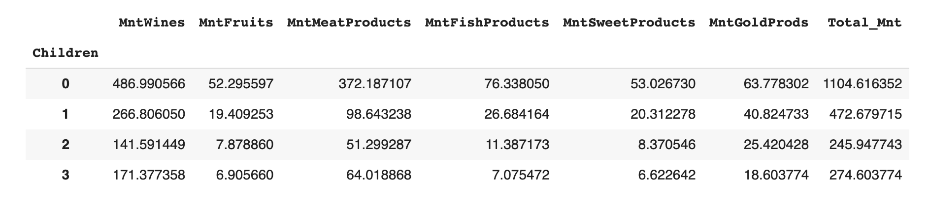
Exploratory Data Analysis
Family
Data: mean spending on each of the categories
No kids: wines + meat + gold
With kids: less gold purchase

Slide 16
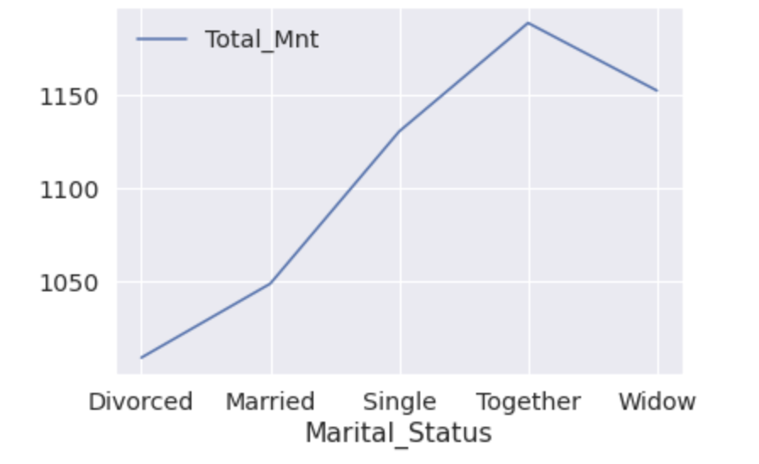
Exploratory Data Analysis
Family
Relationship of spending with marital status (0 kid)
Peak: Together
Stable income
Romantic spending
Trough: Divorced
Less stable income source

Slide 17
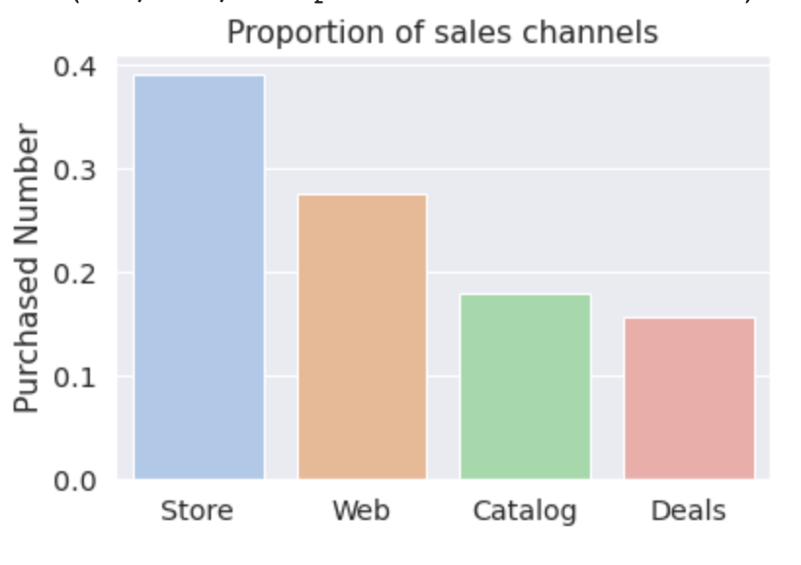
Exploratory Data Analysis
Sales Channel
Channel preference
→ similar across education groups
and countries
Notes:
There are 4 main sales channels, store, web, catalog, and deals, with store being the most important one, accounting for almost 40% of the total purchases. People with different education background share similar purchase preference

Slide 18
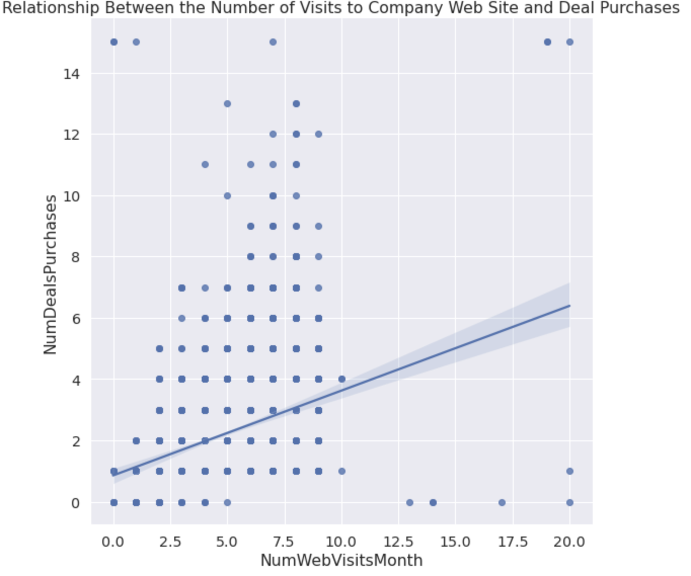
Exploratory Data Analysis
Sales Channel
WebVisit - DealPruchase
→Positive relationship
Website is a great way to promote deals
Notes:
We also looked at the relationship between sales channels and number of web visit per month and we found that it has a positive relationship with number of deals purchases. Our analysis is people tend to check out deals available on the website. Therefore, we suggest using website to promote deals.

Slide 19

Customer Persona & ML
Education: Bachelor
Favorite: Meat & Wine
Age: 51
Kid: 0
Teen: 1
Marital Status : Married
Income: 52K
Country: Spain
Preference: Store
Notes:
Nest, we are gonna talk about customer persona and ml. Overall,

Slide 20
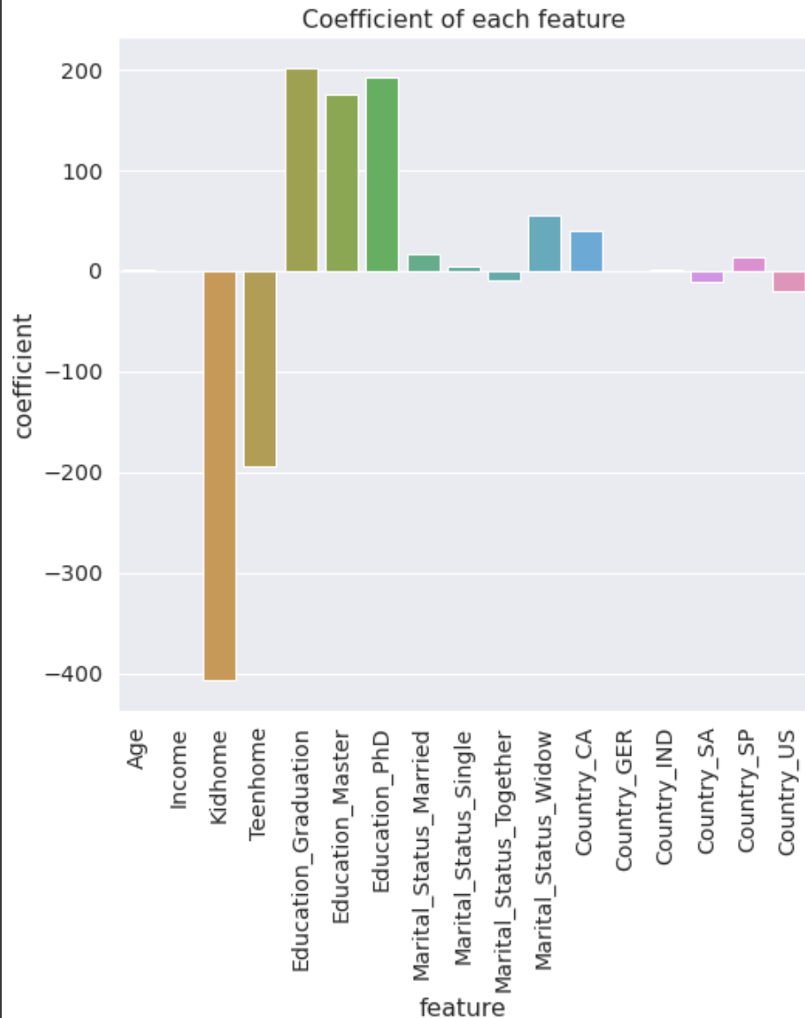
Customer Persona & ML
Linear Regression to infer
Random Forest to predict
Linear Regression | R^2 | 0.587626
 | RMSE | 389.59
Random Forest | R^2 | 0.709599
 | RMSE | 326.93
Average customer prediction: $591
Notes:
As for ML application, we used Linear regression to infer and random forest to predict. As we can see, random forest does a lot better job in predicting than Linear Regression. Using random Forest, we can predict average customer will spend $591, however, the number does tell us much, so we use the linear regression to ran a feature coefficient, as we can see the graph on the right, number of kids at home has the strongest negative relationship with amount spend while education level being the strongest positive coefficient feature

Slide 21



Conclusion
Future Analyze Direction: Check Universality (Do people also … in other retail store company?)
Favorite product category
Favorite Sales Channel
Strongest Positive Feature
Wine
Store
Education_Graduation

Slide 22
Thank You For Your Attention ！

